Slide 1

Artificial Intelligence in Ophthalmology
Jay Chhablani, MD
Professor of Ophthalmology, University of Pittsburgh
Director, Clinical Research, UPMC Eye Center
Director, Choroidal Analysis Research (CAR) Team
Faculty - Clinician, UPMC Eye Center

Slide 2
Financial disclosure
Owner: NetraMind Innovations
Consultant: AbbVie; Novartis; Salutaris; OD-OS; Erasca; B&L, Iveric Bio; Eyepoint
Equity: Ocular therapeutics, AcuViz, Abbvie
Royalty: Springer; Elsevier
No financial disclosure with this presentation
Notes:
Machine learning generally requires 4 steps with manual feature extraction, whereas deep learning can identify labels independently

Slide 3
Revolutionizing Eye Care with Artificial Intelligence (AI): The Future of Ophthalmology
Introduction to AI
Current Applications of AI in Ophthalmology
CHALLENGES
Future
directions
Notes:
Overview of topics

Slide 4
A Brief Introduction to AI
Artificial Intelligence: the ability of computer systems to perform tasks that normally require human intelligence by leveraging algorithms, data, and computational power
Machine Learning: developing systems/algorithms that are trained on large datasets to make decisions and acquire novel skills
Deep Learning: machine learning that employs multi-layered neural networks that mimic those of the human brain
Notes:
AI is defined as above. Classifications you may be familiar with, such as Machine Learning and Deep Learning.

Slide 5
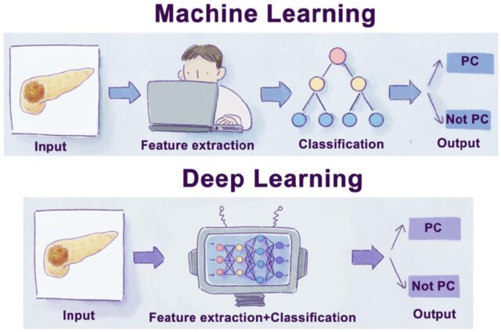
A Brief Introduction to AI: Machine Learning & Deep Learning
Image with permission from Huang, Bowen & Huang, Haoran & Zhang, Shuting & Zhang, Dingyue & Shi, Qingya & Liu, Jianzhou & Guo, Junchao. (2022). Artificial intelligence in pancreatic cancer. Theranostics. Via Creative Commons License CC BY 4.0
Notes:
Machine learning generally requires 4 steps with manual feature extraction, whereas deep learning can identify labels independently

Slide 6
A Brief Introduction to AI: A Closer Look at Popular Deep Learning Models
Convolutional Neural Networks (CNNs): useful for image processing, uses a series of filters
Generational Adversarial Networks (GANs): useful for creating images, two neural networks (one a discriminator, the other a generator) are trained simultaneously against each other
Natural Language Processing (NLP): useful for language comprehension and documentation – includes large language models
Transfer Learning: a model designed for one task can be inserted as the starting point for a separate task
Notes:
Machine learning generally requires 4 steps with manual feature extraction, whereas deep learning can identify labels independently

Slide 7
AI Applications in Healthcare
Logistics - inventory, supply chain management
Data management
Automation of billing, optimization of scheduling
Medical imaging – identifying pathology, quantifying disease progression
Streamlining diagnosis processes
Patient monitoring – wearable devices
Maleki Varnosfaderani S, Forouzanfar M. The Role of AI in Hospitals and Clinics: Transforming Healthcare in the 21st Century. Bioengineering (Basel). 2024 Mar 29;11(4):337.

Slide 8
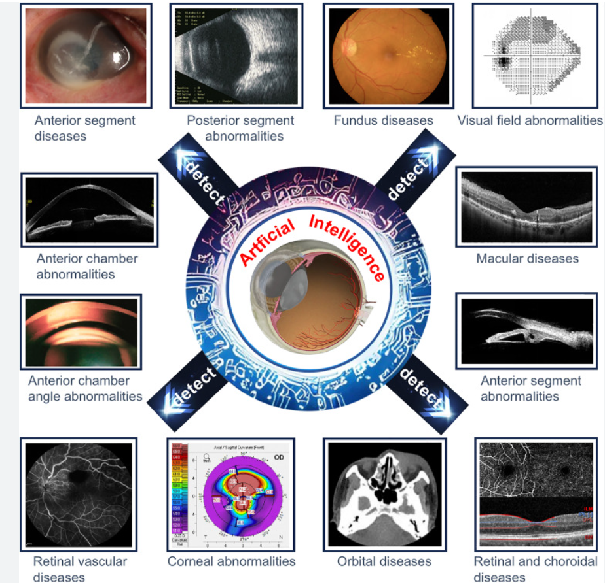
Why Ophthalmology?
Ophthalmology stands out as an ideal specialty for AI applications due to its heavy reliance on imaging-based diagnostics (e.g., fundus photography, optical coherence tomography (OCT)).

Slide 9
Types of Ophthalmic images

Slide 10
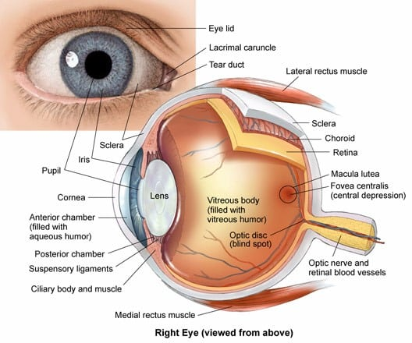
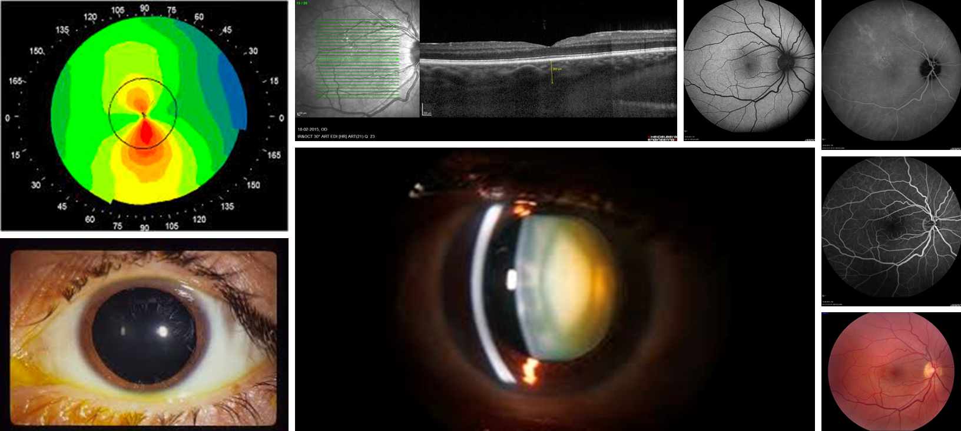
Types of Ophthalmic images

Slide 11
Types of Ophthalmic images
Anterior Segment

Slide 12
Types of Ophthalmic images
Posterior Segment

Slide 13
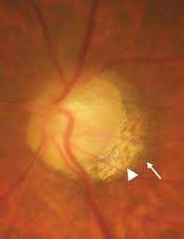
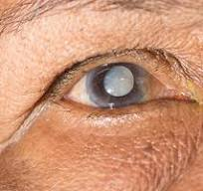
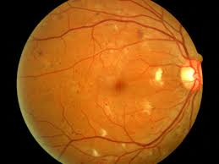
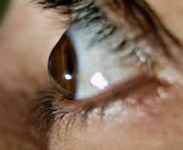
Ophthalmic diseases
Glaucoma
Diabetic
Retinopathy (DR)
Cataract
Keratoconus

Slide 14
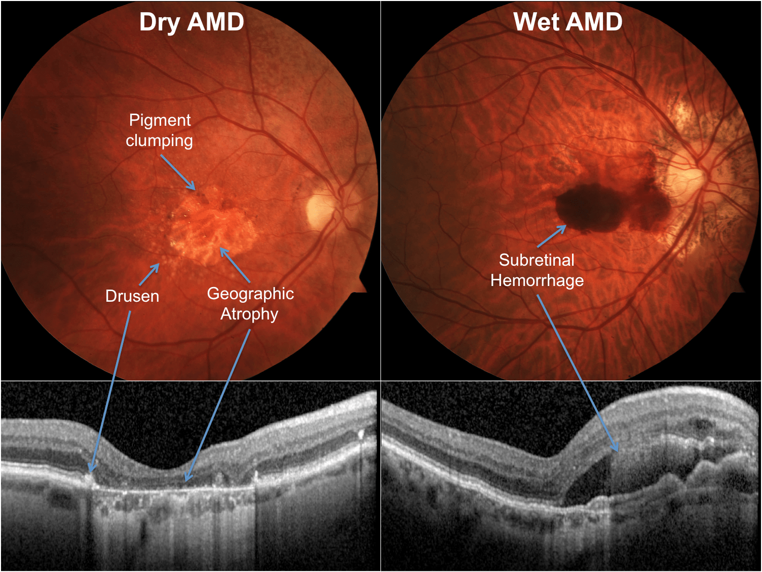
Ophthalmic diseases
Age-related macular
degeneration (AMD)
https://www.acms.org/2019/03/age-related-macular-degeneration-in-2019/

Slide 15
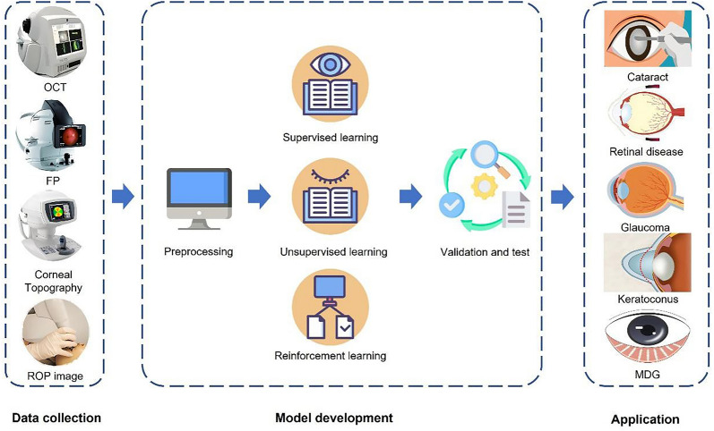

AI in Ophthalmology: Overview of Workflow
Image with permission from Kang D, Wu H, Yuan L, Shi Y, Jin K, Grzybowski A. A Beginner's Guide to Artificial Intelligence for Ophthalmologists. Ophthalmol Ther. 2024 Jul;13(7):1841-1855 via CC BY NC 4.0 License
Notes:
Reinforcement learning (RL) is a machine learning (ML) technique that trains software to make decisions to achieve the most optimal results. It mimics the trial-and-error learning process that humans use to achieve their goals.

Slide 16
Applications in Ophthalmology

Slide 17
Segmentation
Classification
Prediction
Generation
Notes:
So far, AI in ophthalmology has focused on accomplishing several core tasks including segmentation, classification, prediction, and generation

Slide 18
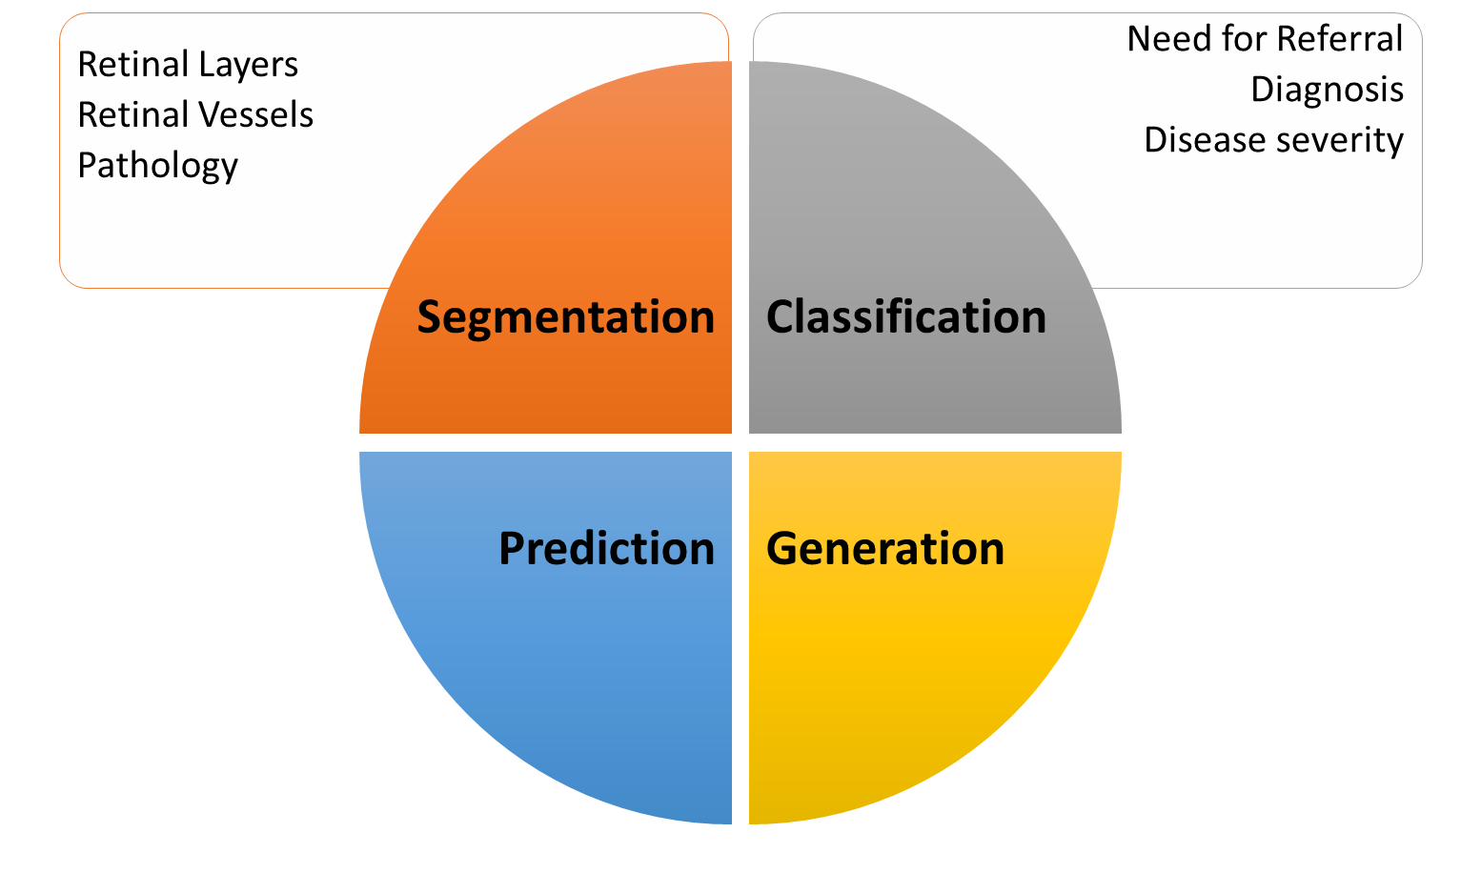
Need for Referral
Diagnosis
Disease severity
Classification
Notes:
Classification is the task of assigning a category to a given input. For example, a classification algorithm may be used to detect high myopia from a fundus image. Other algorithms have been trained to classify images as one of many retinal diseases, doing so very accurately. Others may classify known diseases, like diabetic retinopathy, into subcategories based on biomarkers like neovascularization.

Slide 19
AI in Ophthalmology: Image-based Applications in Anterior Segment Diseases
Cataract
High accuracy in detection and quantification of NS and PSC from slit lamp images and retroillumination images
Deep learning model DeepLensNet
Using fundus images to screen for visually-significant cataracts (VA 20/60 or worse) with AUCs (0.916–0.965)
Improve IOL calculation formulas
Li T, Stein J, Nallasamy N. AI-powered effective lens position prediction improves the accuracy of existing lens formulas. Br J Ophthalmol. 2022. Sep
Wang T, et al. Intelligent cataract surgery supervision and evaluation via deep learning. Int J Surg. 2022. Aug
Keenan T.D.L., et al. DeepLensNet: deep learning automated diagnosis and quantitative classification of cataract type and severity. Ophthalmology. 2022
Tham Y.C, et al. Detecting visually significant cataract using retinal photograph-based deep learning. Nat. Aging. 2022
Notes:
AI can receive inputs such as imaging data and identify outputs such as presence or absence of retinal disease

Slide 20
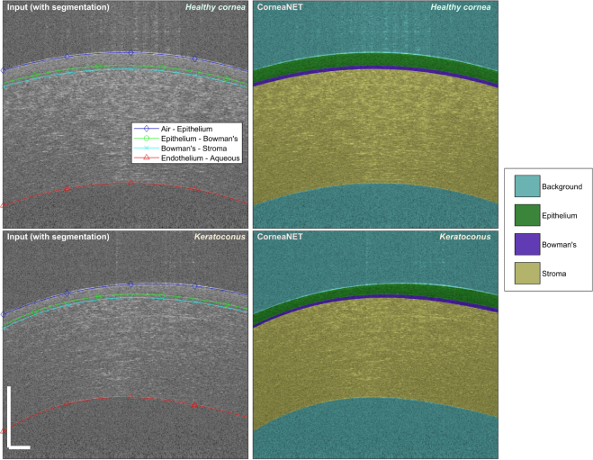
AI in Ophthalmology: Image-based Applications in Anterior Segment Diseases
Cornea
CorneaNet: assesses and measures the corneal layers via AS-OCT in keratoconus patients with accuracy up to 99.4%
Potential applications in diagnosing keratoconus and studying corneal morphology
Dos Santos, et al. CorneaNet: Fast segmentation of cornea OCT scans of healthy and keratoconic eyes using deep learning. Biomed Opt Express. 2019
Li Z., et al. Preventing corneal blindness caused by keratitis using artificial intelligence. Nat Commun. Jun 18 2021
Dense anatomical annotation of slit-lamp images improves the performance of deep learning for the diagnosis of ophthalmic disorders.
Notes:
Figure CorneaNet automatically segments cornea OCT images with high accuracy. Segmentation of healthy and keratoconic corneas using the Matlab algorithm and CorneaNet. Keratoconic corneas exhibit usually at least one layer with non-uniform thickness. Scale bar: 250 μm

Slide 21
AI in Ophthalmology: Image-based Applications in Anterior Segment Diseases
Cornea
Deep learning system for automated keratitis classification based on slit lamp and smartphone images (AUCs >0.96)
Artificial neural networks trained to recognize and differentiate between corneal ulcers of bacterial and fungal etiology vs clinician (90% vs 62.8%)
Dos Santos, et al. CorneaNet: Fast segmentation of cornea OCT scans of healthy and keratoconic eyes using deep learning. Biomed Opt Express. 2019
Li Z., et al. Preventing corneal blindness caused by keratitis using artificial intelligence. Nat Commun. Jun 18 2021
Dense anatomical annotation of slit-lamp images improves the performance of deep learning for the diagnosis of ophthalmic disorders.
Notes:
AI can receive inputs such as imaging data and identify outputs such as presence or absence of retinal disease

Slide 22
AI in Ophthalmology: Image-based Applications in Glaucoma
Glaucoma Screening, Diagnosis, Prognosis
Referable glaucomatous optic neuropathy detected from fundus photographs by deep-learning algorithm (sensitivity/specificity of 95.6%/92%)
AI enhances OCT (optic nerve)-based detection of glaucomatous progression (AUC 0.969)
Predicting glaucoma progression from visual fields 3.5 years earlier using machine-learning
Zhixi Li et al; An Automated Grading System for Detection of Vision-Threatening Referable Diabetic Retinopathy on the Basis of Color Fundus Photographs. Diabetes Care 1 December 2018
Ran A.R, et al. Detection of glaucomatous optic neuropathy with spectral-domain optical coherence tomography: a retrospective training and validation deep-learning analysis. Lancet. Digit. Health. 2019
Yousefi S., Kiwaki T., Zheng Y., Sugiura H., Asaoka R., Murata H., Lemij H., Yamanishi K. Detection of longitudinal visual field progression in glaucoma using machine learning. Am. J. Ophthalmol. 2018
Notes:
AI can receive inputs such as imaging data and identify outputs such as presence or absence of retinal disease

Slide 23
AI in Ophthalmology: Image-based Applications in Retinal Disease
Diabetic Retinopathy Screening
DeepDR for early detection of mild NPDR (sensitivity/specificity=88%/84%)
Three deep-learning sub-networks: image quality assessment sub-network, lesion-aware sub-network, and DR grading sub-network
Autonomous FDA-cleared technologies for DR screening enhance care access (sensitivity/specificity):
IDx-DR (87%/90%)
EyeArt system (Eyenuk, Inc) (96%/88%)
Dai L et al. A deep learning system for detecting diabetic retinopathy across the disease spectrum. Nat Commun. 2021 May
Abràmoff MD et al. Pivotal trial of an autonomous AI-based diagnostic system for detection of diabetic retinopathy in primary care offices. NPJ Digit Med. 2018 Aug
Ipp E, EyeArt Study Group et al. Pivotal Evaluation of an Artificial Intelligence System for Autonomous Detection of Referrable and Vision-Threatening Diabetic Retinopathy. JAMA Netw Open. 2021 Nov
Notes:
AI can receive inputs such as imaging data and identify outputs such as presence or absence of retinal disease

Slide 24
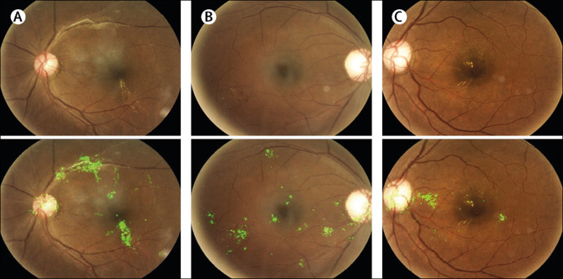
AI in Ophthalmology: Image-based Applications in Retinal Disease
Diabetic Retinopathy Screening
AI model validated in mobile screening project in Zambia: 4504 fundus photos from patients with diabetes, referable DR found in 22.5% of eyes
Bellemo V et al. Artificial intelligence using deep learning to screen for referable and vision-threatening diabetic retinopathy in Africa: a clinical validation study. Lancet Digit Heal [Internet]. 2019
Notes:
Heat map using integrated gradient method
Positive cases of referable DR – the green coloured areas in the retinal fundus images show the contribution to the artificial intelligence model's assignment of the predicted referable diabetic retinopathy diagnosis. The images show fibrovascular proliferation associated with hard exudate located close to fovea region
A) Moderate DR, changes around macula
B) ahard exudate and hemorrhage
C) The modifications flagged in green are sometimes missed by retinal specialists and ophthalmologists due to poor image quality and heat map visualisation can aid in making a diagnosis. The resolution of the fundus overlay (512 × 512 pixels) produced by the model is slightly smaller than the original image resolution, due to the down-sampling effect during the pre-processing phase.

Slide 25
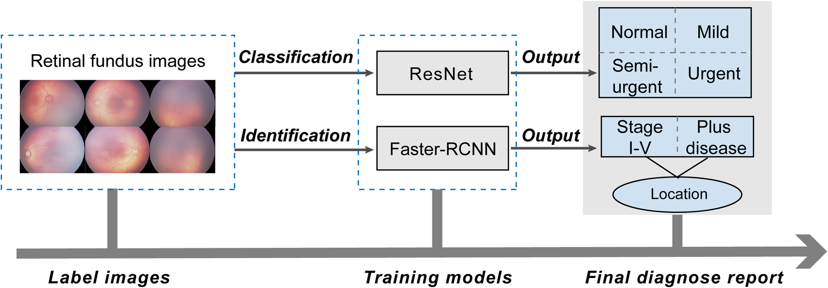
AI in Ophthalmology: Image-based Applications in Retinal Disease
Retinopathy of Prematurity (ROP) Screening
Using CNN-based deep learning system to detect and classify ROP (four stages) from fundus photographs in a clinical setting (table depicts accuracy)
Tong Y, Lu W, Deng QQ, Chen C, Shen Y. Automated identification of retinopathy of prematurity by image-based deep learning. Eye Vis (Lond). 2020 Aug
Notes:
AI can receive inputs such as imaging data and identify outputs such as presence or absence of retinal disease

Slide 26
AI in Ophthalmology: Image-based Applications in Retinal Disease
Age-Related Macular Degeneration (AMD)
Detection of large drusen, pigmentary abnormalities, and late AMD using fundus photographs from AREDS - deep learning system
AUC (0.94, 0.93, and 0.97)
Predicting risk of fellow eye conversion within six months in exudative AMD with OCT - segmentation network
80% sensitivity at 55% specificity and 34% sensitivity at 90% specificity
Yeh TC et al. Prediction of treatment outcome in neovascular age-related macular degeneration using a novel convolutional neural network. Sci Rep. 2022
Yim J., et al. Predicting conversion to wet age-related macular degeneration using deep learning. Nat. Med. 2020
Peng Y., DeepSeeNet: a deep learning model for automated classification of patient-based age-related macular degeneration severity from color fundus photographs. Ophthalmology. 2019
Notes:
AI can receive inputs such as imaging data and identify outputs such as presence or absence of retinal disease

Slide 27
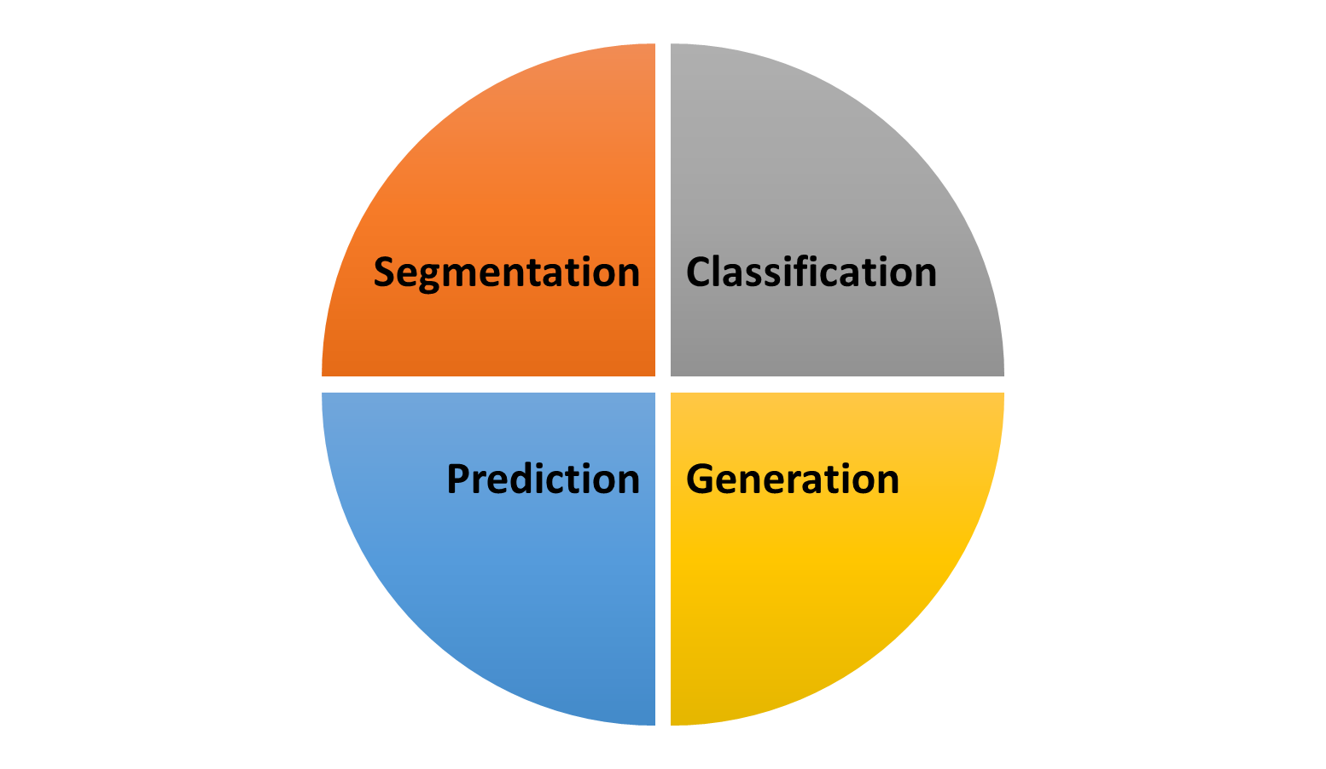
Retinal Layers
Pathology
Retinal Vessels
Segmentation
Notes:
Segmentation is the partitioning of an image into multiple segments defined by a set of pixels. It has been proven to be a reliable biomarker for a number of diseases, but is a labor-intensive task if done manually. AI has improved workflow and accuracy in segmentation.

Slide 28
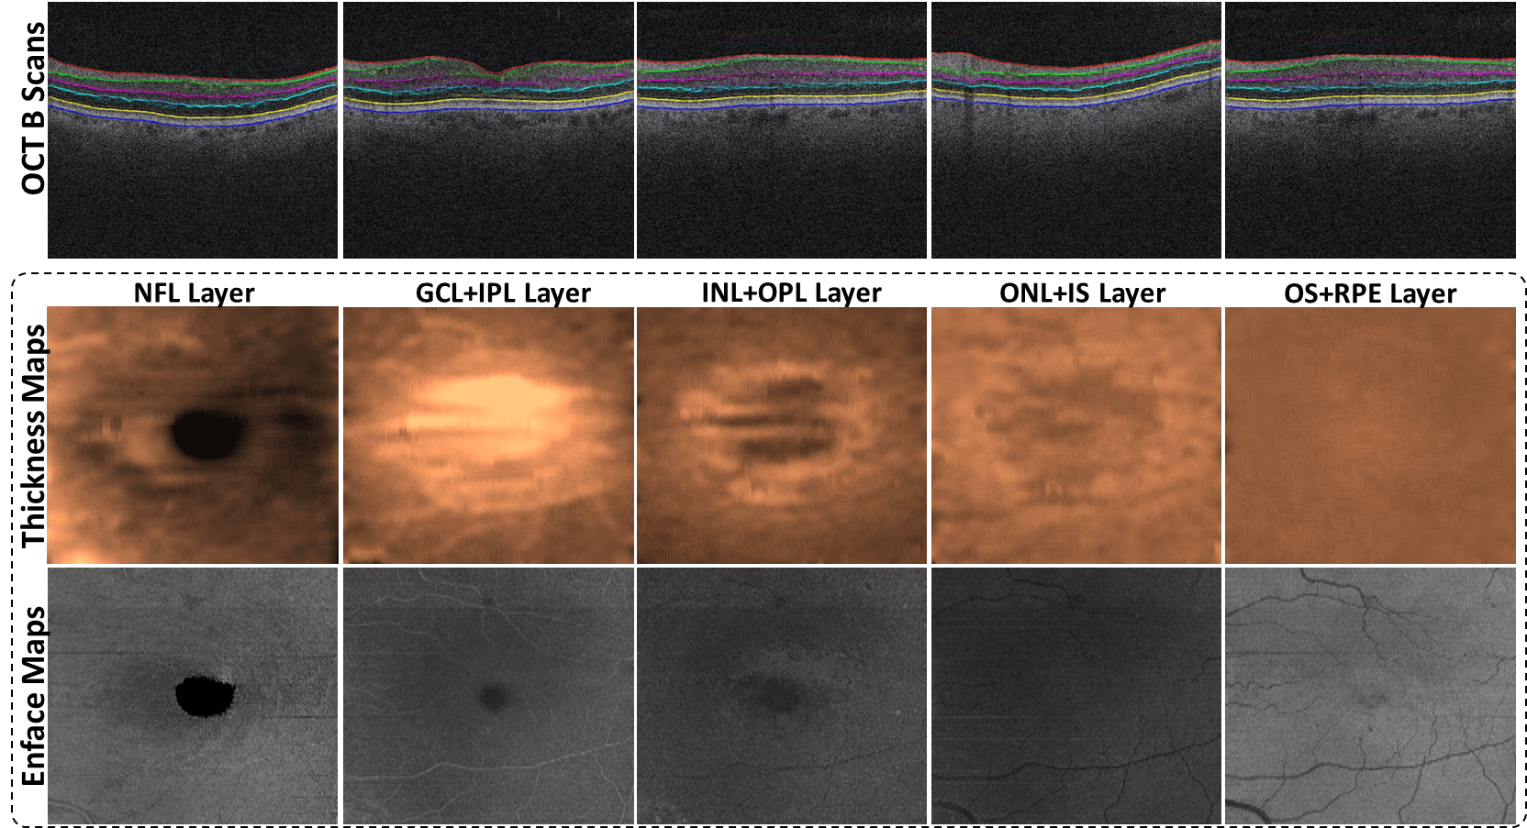
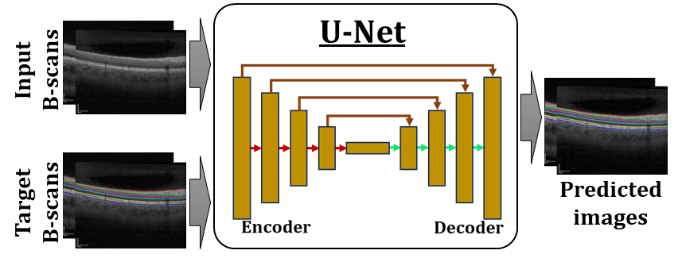
AI-based feature extraction OCT retinal sublayer thickness quantification

Slide 29
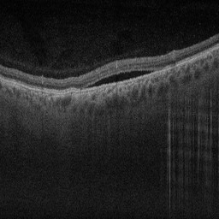
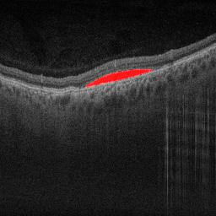
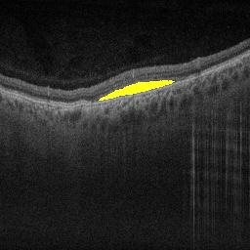

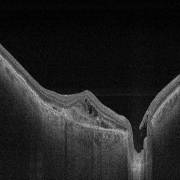
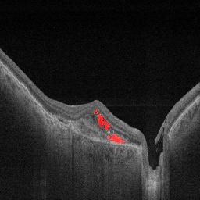
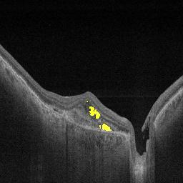
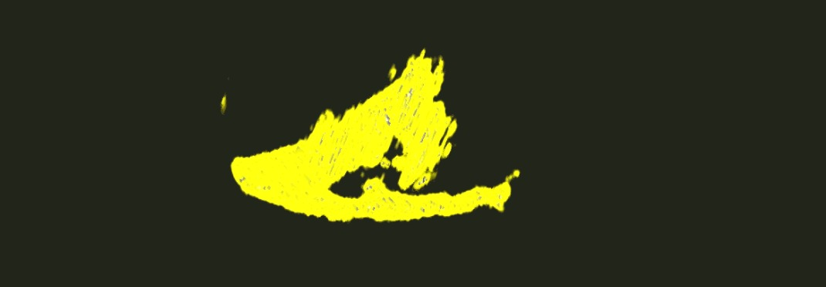
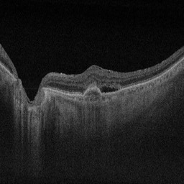
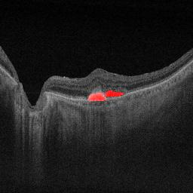
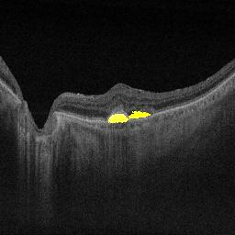
Quantification of imaging biomarkers
Retinal fluids
Voxel-level segmentation of cysts in 3D volume
Raw OCT
Ground Truth
Predicted
Ground Truth voxels
Retinal cysts
Predicted voxels
Representative OCT scans with segmentation of retinal fluids
Manne, S. R., Selvam, A., Patel, M., Kuchhal, A., Sahel, J. A., Chhablani, J., Vupparaboina, K. K., and Jana, S. “Automatic identification and quantification of retinal cysts in optical coherence tomography images using deep residual encoder-decoder architecture,”Investigative Ophthalmology & Visual Science,. 2022.

Slide 30
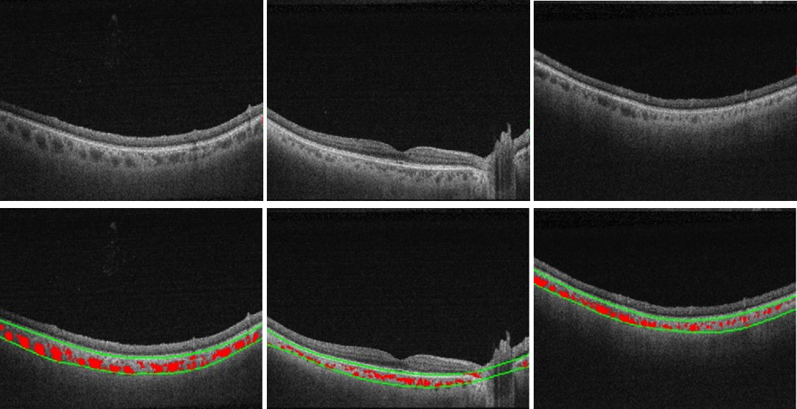
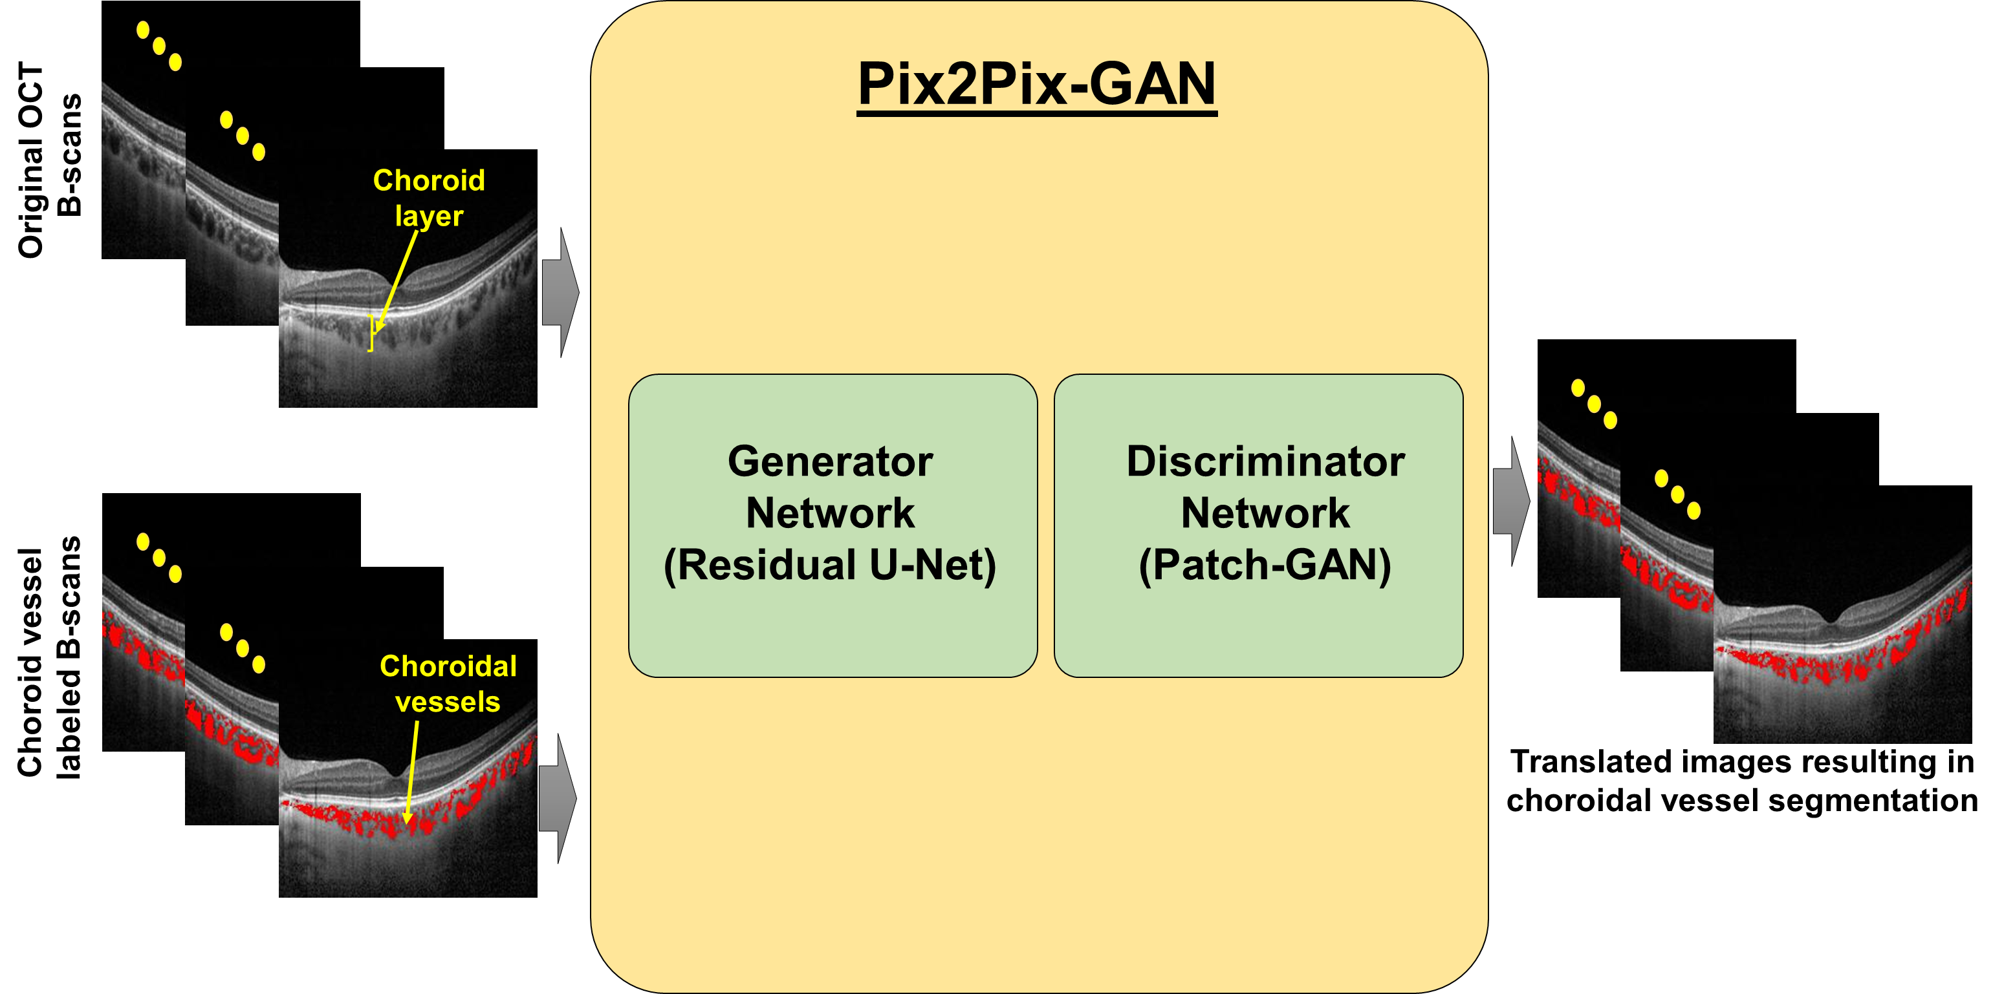
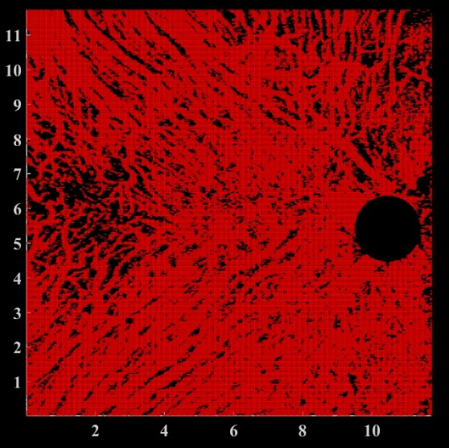
AI-based feature extraction Choroidal vessel segmentation

Slide 31
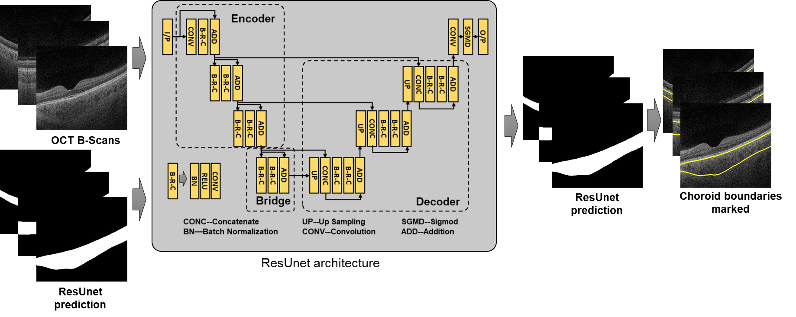
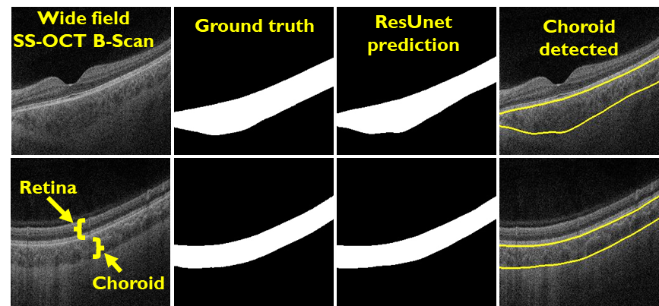
AI-based feature extraction Choroidal layer segmentation
Vupparaboina KK, Selvam A, Suthaharan S, Ibrahim MN, Jana S, Sahel JA, Dansingani KK, Chhablani J. Automated choroid layer segmentation based on wide-field SS-OCT images using deep residual encoder-decoder architecture. Investigative Ophthalmology & Visual Science. 2021 Jun 21;62(8):2162-.

Slide 32
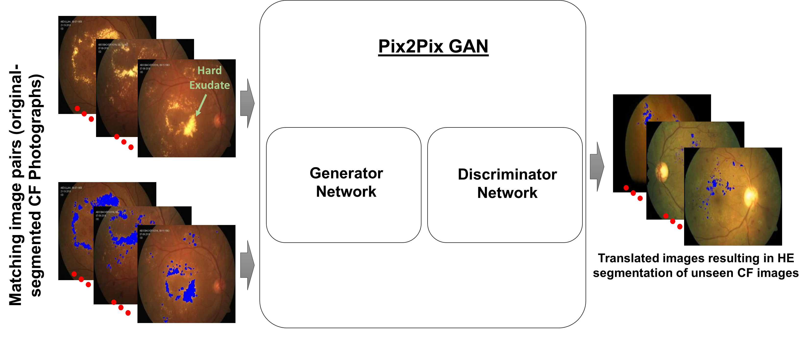
Hard Exudates Quantification in Color Fundus Images
Vinisha Sant; Sandeep Chandra Bollepalli; Jose Alain Sahel; Jay Chhablani; Kiran Kumar Vupparaboina; Invest. Ophthalmol. Vis. Sci.. 2022; [ARVO 2023, accepted]

Slide 33
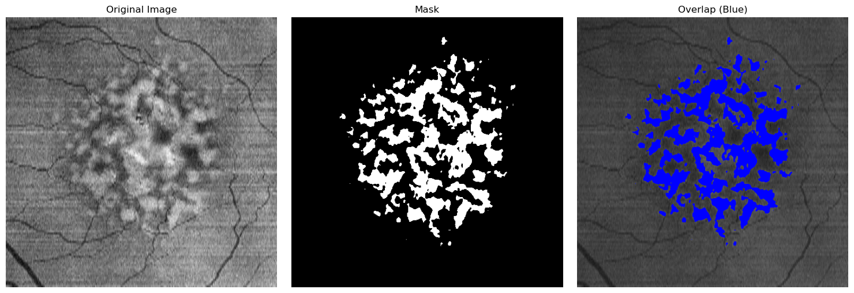
Automated Drusen Quantification – AMD screening

Slide 34
AI in Ophthalmology: Image-based Applications in Retinal Disease
Retinal AI Diagnosis System (RAIDS)
Deep learning algorithm that detects 10 retinal pathologies from fundus photographs
Study used >120,000 images
Accuracy in detecting AMD, retinal vein occlusions, macular holes, epiretinal macular membrane, hypertensive retinopathy, myelinated fibers, and retinitis pigmentosa ranged from 0.982 to 1.000
Equal to or greater than diagnostic accuracy of trained clinicians for these diseases
Possible applications of such systems include increasing care access in rural/underserved areas
Dong L, et al. Artificial Intelligence for Screening of Multiple Retinal and Optic Nerve Diseases. JAMA Netw Open. 2022 May
Notes:
AI can receive inputs such as imaging data and identify outputs such as presence or absence of retinal disease

Slide 35
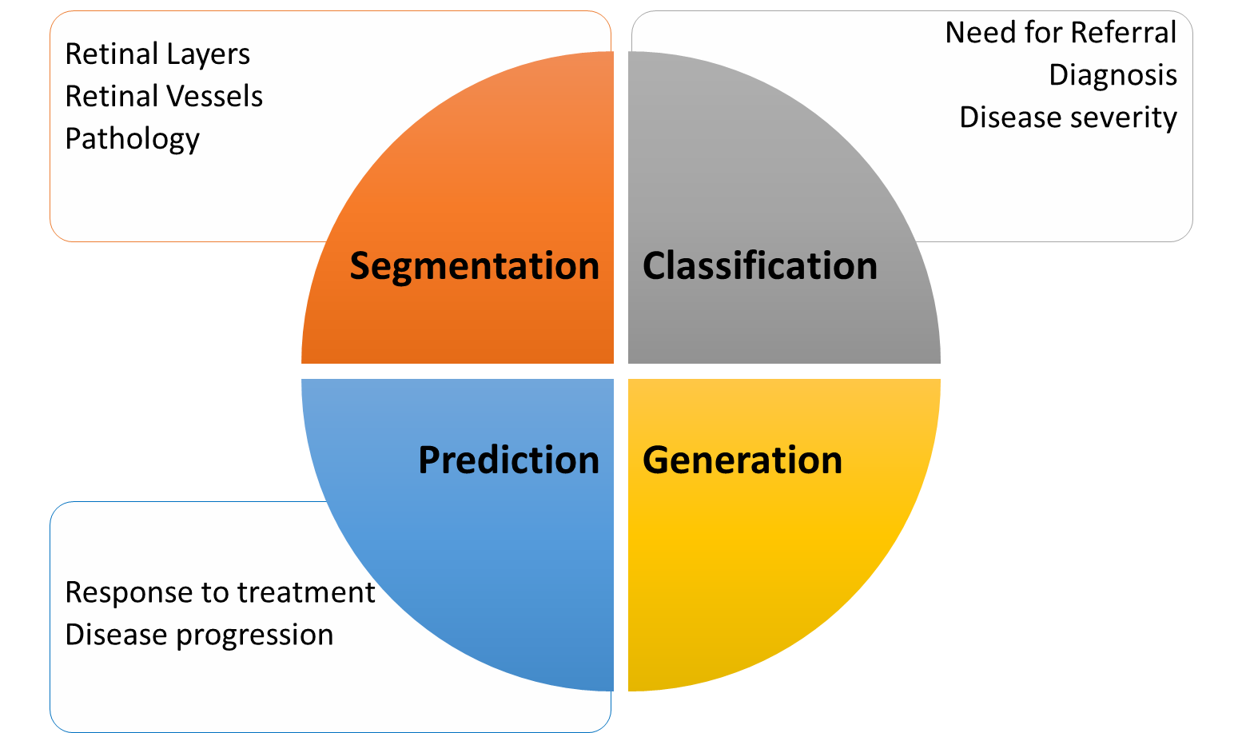
Response to treatment
Disease progression
Prediction
Notes:
Prediction is closely related to classification, but often outputs a value or outcome rather than a category. This may look like the prediction of the best-corrected visual acuity based on a set of clinical factors. Prediction also encompasses tasks that evaluate future outcomes such as the chance of fluid recurrence or progression to late stage age-related macular degeneration.

Slide 36
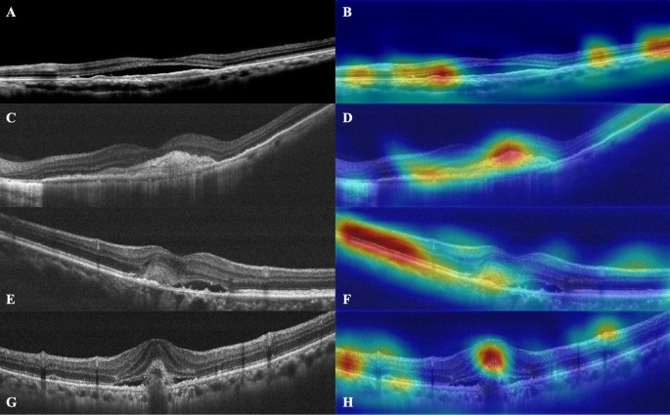
AI in Ophthalmology: Image-based Applications in Retinal Disease
Age-Related Macular Degeneration (AMD)
A CNN-based deep learning system developed to predict visual acuity (VA) response to anti-VEGF therapy based on pre-treatment OCT
Model predicted likelihood of VA improvement at one-year AUROC (0.99), accuracy (94%)
Yeh TC et al. Prediction of treatment outcome in neovascular age-related macular degeneration using a novel convolutional neural network. Sci Rep. 2022
Yim J., et al. Predicting conversion to wet age-related macular degeneration using deep learning. Nat. Med. 2020
Peng Y., DeepSeeNet: a deep learning model for automated classification of patient-based age-related macular degeneration severity from color fundus photographs. Ophthalmology. 2019
Notes:
AI can receive inputs such as imaging data and identify outputs such as presence or absence of retinal disease
Figure indicates: OCT with superimposed heatmaps at different focus points – A OCT of improved case (predicted by HDF-Net B network found margin of SRF, EZ C OCT with orrect prediction of improvement, D heatmap focuses on subfoveal disciform scar and disruption of the EZ E: CNN predicted to improve but the VA did not F: heatmap focuses on preserved EZ and the subretinal hyperreflective material (SHRM) with fibrovascular components. (G) An example of an OCT image with the HDF-Net predicted not to improve but the patient demonstrated VA improvement > = 2 lines (82 M; baseline VA:0.4; 12th month VA: 0.6); (H) The attention is located on the SHRM with fibrovascular/hemorrhagic components. Also some attention on the disruption of the EZ and the hyperreflective zone of the inner retina.

Slide 37
AI in Ophthalmology: Image-based Applications in Retinal Disease
Neurodegenerative Disease
AI measurement of retinal vessel caliber as an indicator of risk of cognitive decline
Narrow retinal arterial caliber and wider retinal venular caliber assoc. with increased risk of cognitive impairment
Detecting Alzheimer’s dementia from retinal photographs:
Accurate performance for differentiating AD+ and AD- patients and for differentiating individuals who were amyloid B positive and negative
Carol Cheung et al.. A deep learning model for detection of Alzheimer's disease based on retinal photographs: a retrospective, multicentre case-control study Lancet Digit Health. 2022
Cheung CY,, et al. Deep-learning retinal vessel calibre measurements and risk of cognitive decline and dementia. Brain Commun. 2022
Notes:
AI can receive inputs such as imaging data and identify outputs such as presence or absence of retinal disease

Slide 38
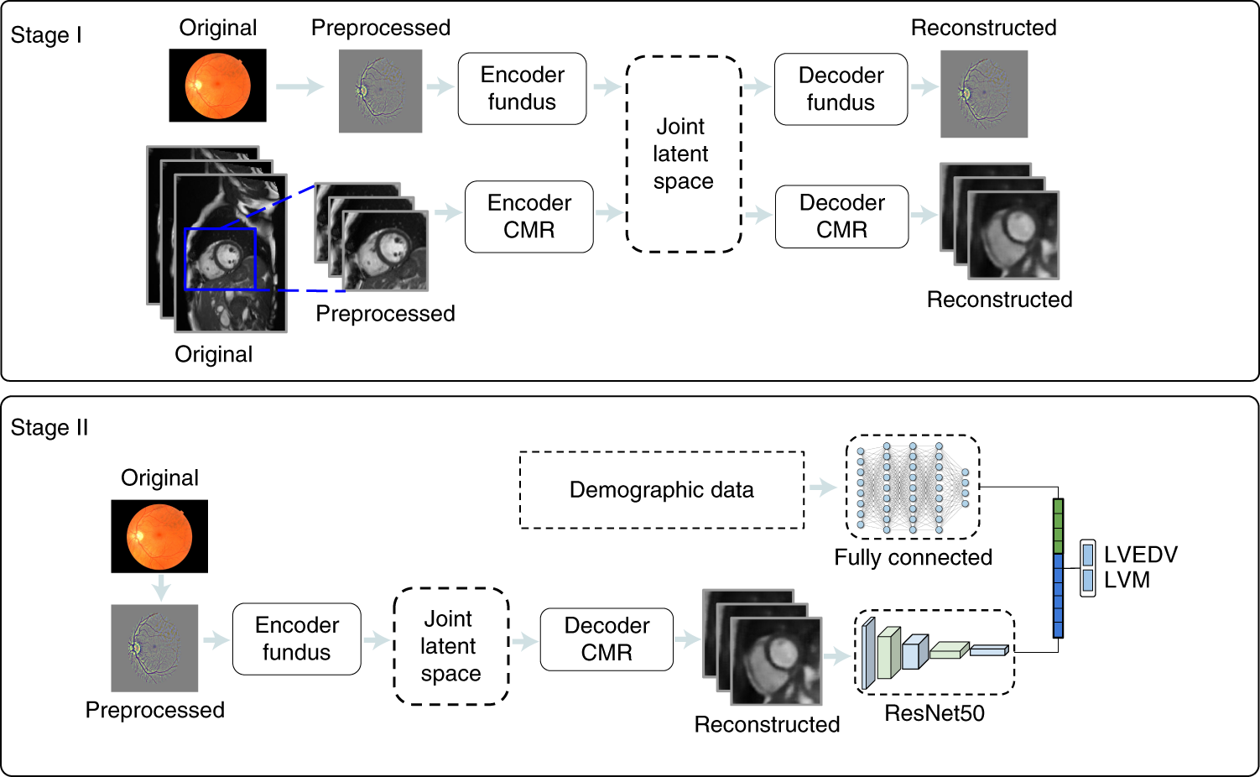
AI in Ophthalmology: Image-based Applications in Retinal Disease
Cardiovascular Disease
AI system that combines retinal images with demographic data to predict risk of MI (AUC 0.80, sensitivity/specificity 0.74/0.71) (Figure at Right)
RetiCAC: deep learning algorithm based on fundus photographs that identified presence of coronary artery calcium deposition (AUC 0.742)
Rim TH, Lee CJ, Tham YC, Cheung N, Yu M, Lee G, et al. Deep-learning- based cardiovascular risk stratification using coronary artery calcium scores predicted from retinal photographs. Lancet Digit Health. 2021
Diaz-Pinto, A., Ravikumar, N., Attar, R. et al. Predicting myocardial infarction through retinal scans and minimal personal information. Nat Mach Intell 4, 55–61 (2022)
Notes:
Figure: This system comprises two main components: a mcVAE and a deep regressor network. During Stage I, a joint latent space is created with two channels: retinal and cardiac magnetic resonance. Then, during Stage II a deep regressor is trained on the reconstructed CMR plus demographic data to estimate LVM and LVEDV. Figure rreproduced with permission from UK Biobank.

Slide 39
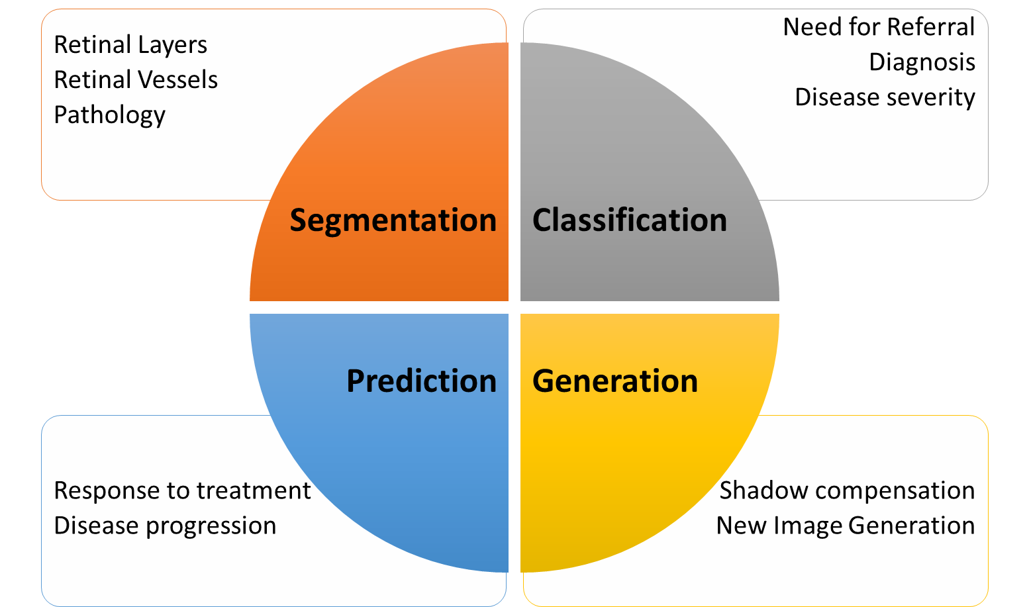
Shadow compensation
New Image Generation
Generation
Notes:
Generation is another domain of AI in ophthalmology. Some examples include:
Registration, which is the automatic alignment of images to one another.
Synthetic image generation, which creates useful images from other modalities, when not available. For example, it is possible to predict OCT measures from fundus photos.
And denoising, which is a new and promising application that removes hindering artifacts, like speckle noise, low signal strength, and blink and motion artifacts, from images.

Slide 40
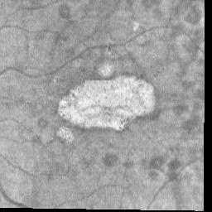
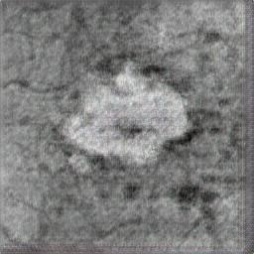
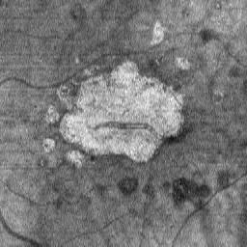
AI in Ophthalmology: Image-based Applications in Retinal Disease
Progression of advanced Age-Related Macular Degeneration (AMD)
AI-generated predicted image at 2 years
Original image at 2 years
Baseline

Slide 41
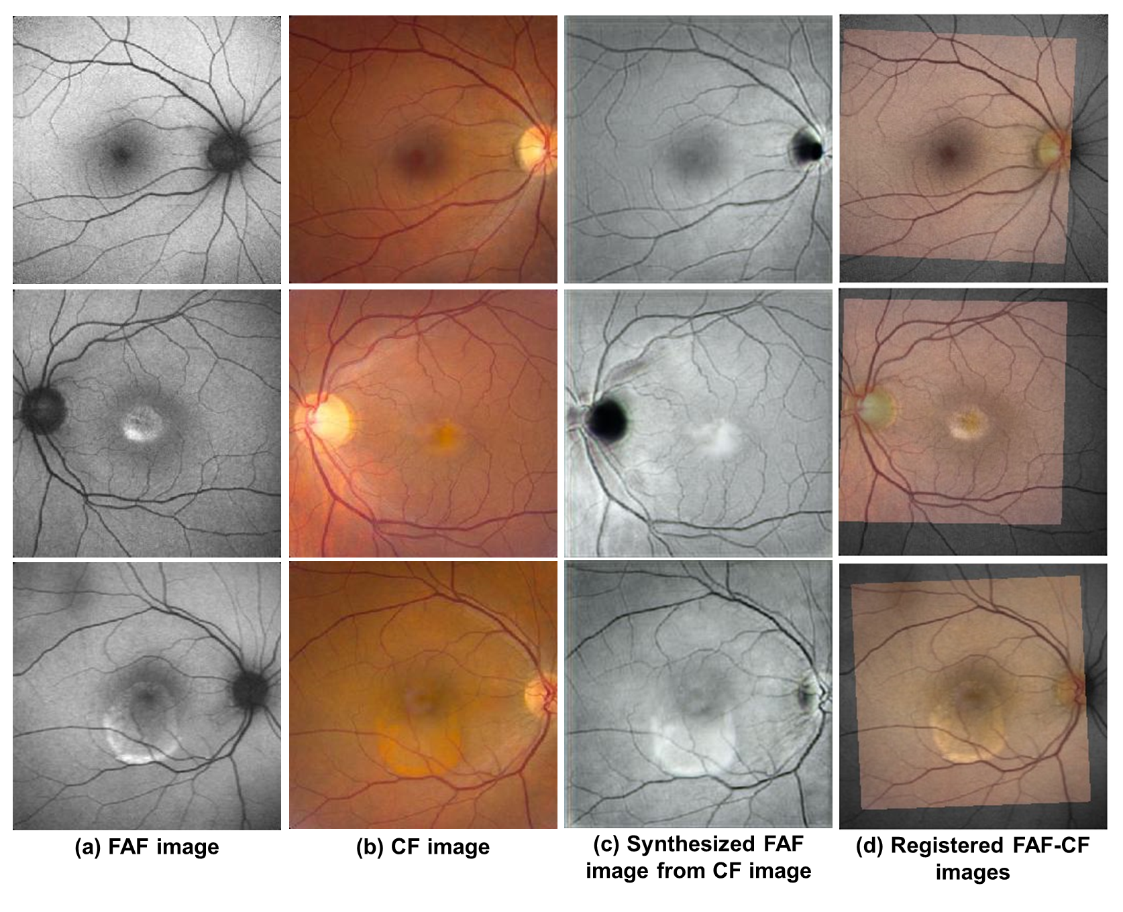
Image Synthesis: Color fundus to Fundus Autofloroscene
Current application: Multimodal Image Registration
Bollepalli, Sandeep Chandra; Gadari, Adarsh; Arasikere, Raveena; Darandale, Aditi ; Suthaharan, Shan; Dansingani, Kunal K.; Sahel, Jose; Chhablani, Jay; Vupparaboina, Kiran K. Multimodal Ophthalmic Image Registration: A Generalizable Framework Based on Image Synthesis using Cycle Generative Adversarial Networks. [ARVO 2023, Accepted]

Slide 42
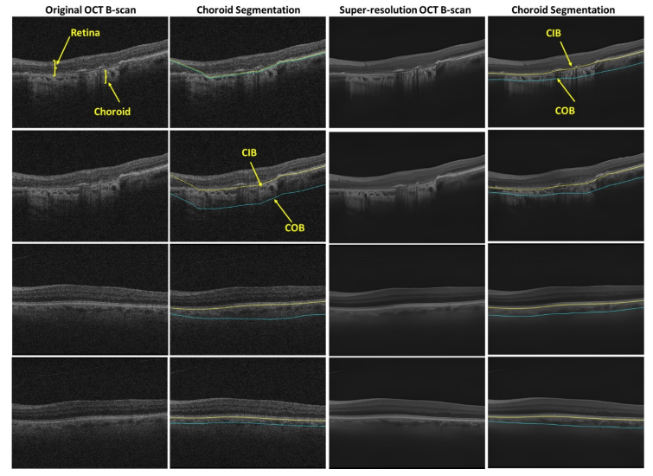
Super resolution
Chhablani, Jay; Sahel, Jose; Vupparaboina, Kiran K.; Jana, Soumya; B, Sharanya; Bollepalli, Sandeep Chandra. Super-resolution of low-quality spectral domain optical coherence tomography images to enable choroidal biomarker detection. [ARVO 2023, accepted]

Slide 43
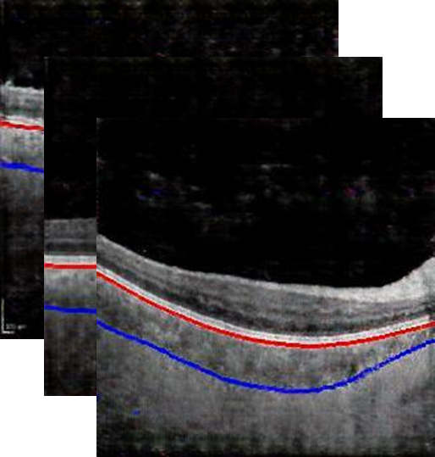
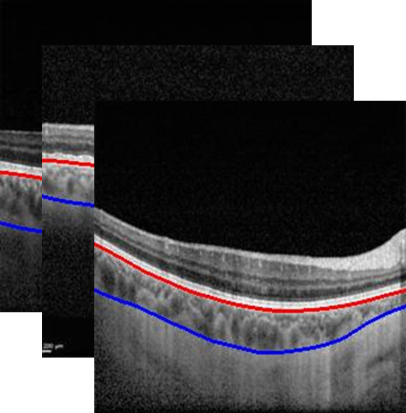
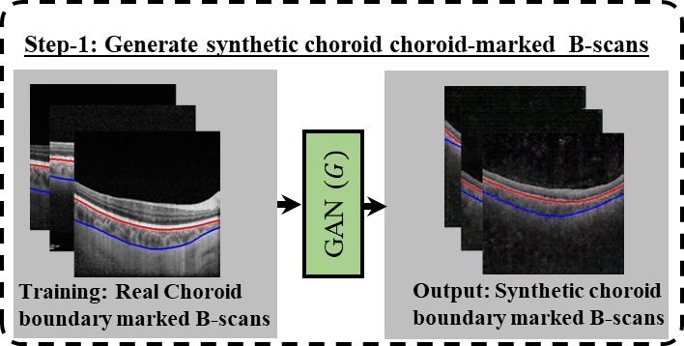
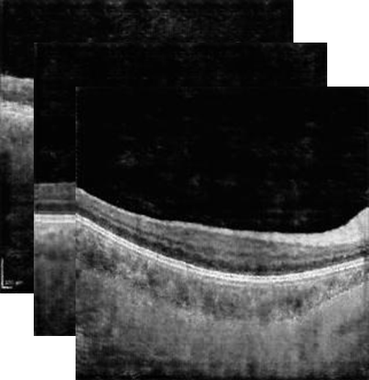
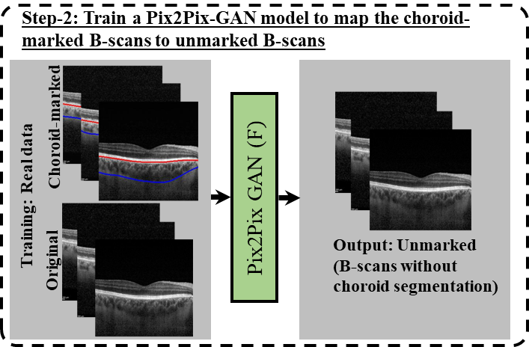
Feature quantification based on synthetic Images Choroid layer segmentation
Synthetic Image pairs
Data privacy/Federated learning
STEP-1
Choroid-marked
STEP-3
Train an AI model for
Choroid layer Segmentation
STEP-2
Real Choroid-marked images
Unmarked
Vupparaboina KK, Bollepalli SC, Ibrahim MN, Selvam A, Kurakula SV, Mohammed AR, Mayer N, Sahel JA, Chhablani J. Protecting Privacy while Improving Choroid Layer Segmentation in OCT Images: A GAN-based Image Synthesis Approach. Available at SSRN 4705376. 2023 Dec 7.

Slide 44
AI in Ophthalmology: Large Language Models
Include chatbots such as ChatGPT (OpenAI, San Francisco, CA, USA)
ChatGPT Legacy achieves accuracy of 55% on BCSC question set
Dr. ChatGPT?
2023 study: appropriateness and readability of ChatGPT-4’s responses to questions about vitreoretinal surgery
Responses reviewed by retina specialists for appropriateness
Appropriateness scores between 84.6%-92%
However, responses were challenging to read for laypersons and required college graduate-level education
Momenaei B, et al. Appropriateness and Readability of ChatGPT-4-Generated Responses for Surgical Treatment of Retinal Diseases. Ophthalmol Retina. 2023 Oct
Antaki F, Touma S, Milad D, El-Khoury J, Duval R. Evaluating the Performance of ChatGPT in Ophthalmology: An Analysis of Its Successes and Shortcomings. Ophthalmol Sci. 2023 May 5
Notes:
AI can receive inputs such as imaging data and identify outputs such as presence or absence of retinal disease

Slide 45
AI in Ophthalmology: Future Implementations of Large Language Models
Reviewed comprehensively by Betzler et al in “Large Language Model and its Impact in Ophthalmology”
Remote triaging, linkage to mobile applications in primary care settings
Streamlining appointment scheduling, automating form completion
AI in preparing documentation such as discharge summaries, notes etc.
Ophthalmology education: simulating patients, summarizing texts
Betzler BK, et al. Large language models and their impact in ophthalmology. Lancet Digit Health. 2023 Dec
Notes:
AI can receive inputs such as imaging data and identify outputs such as presence or absence of retinal disease

Slide 46
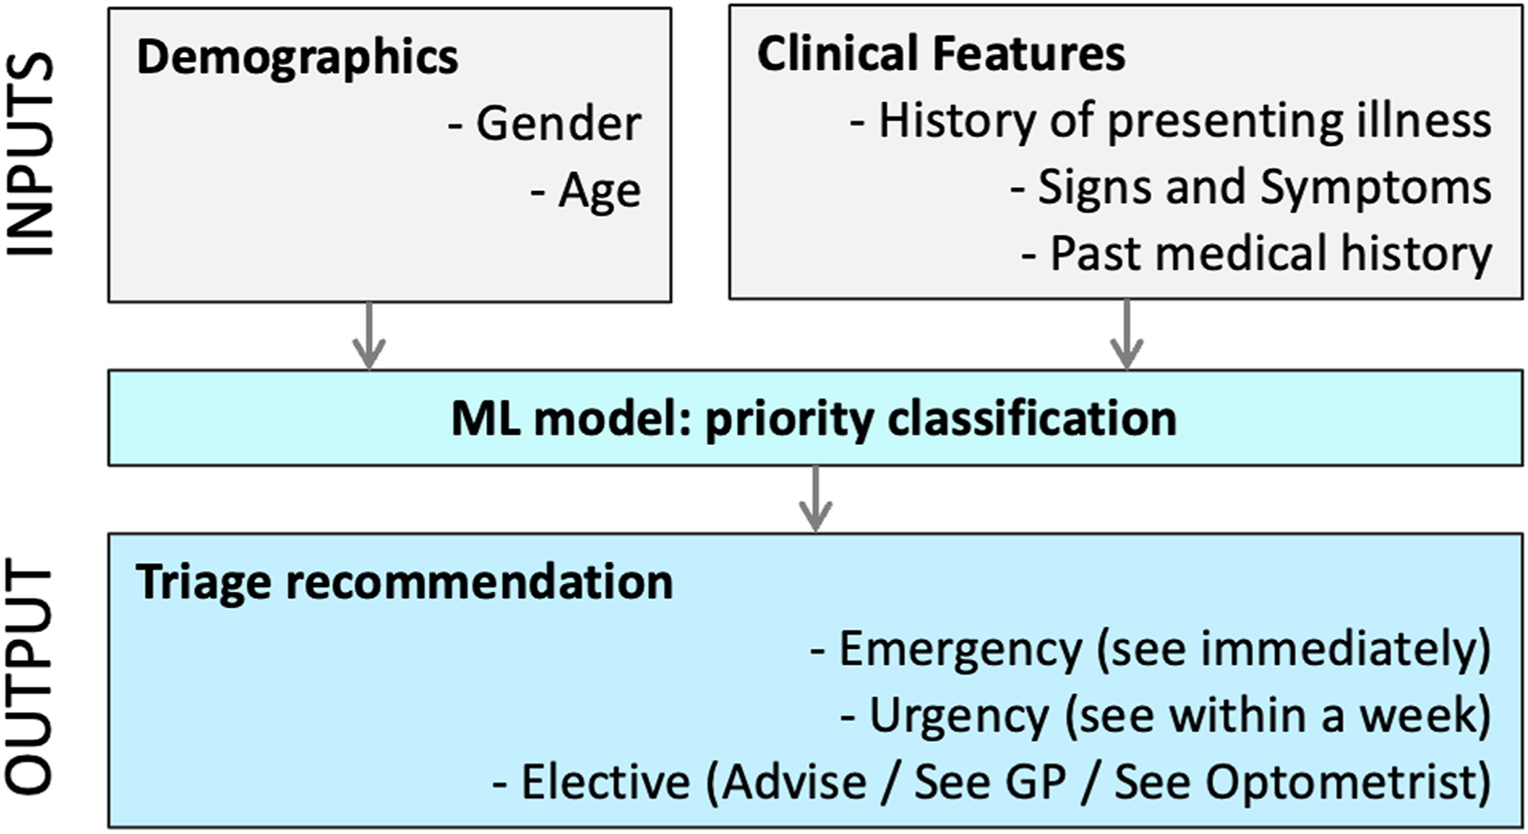
AI in Ophthalmic Triage: The DOTS System
Architecture of the proposed machine learning-based ophthalmic triage system. Demographics and clinical features form the inputs. The model outputs a 3-class priority recommendation.
GP: general practitioner.

Slide 47
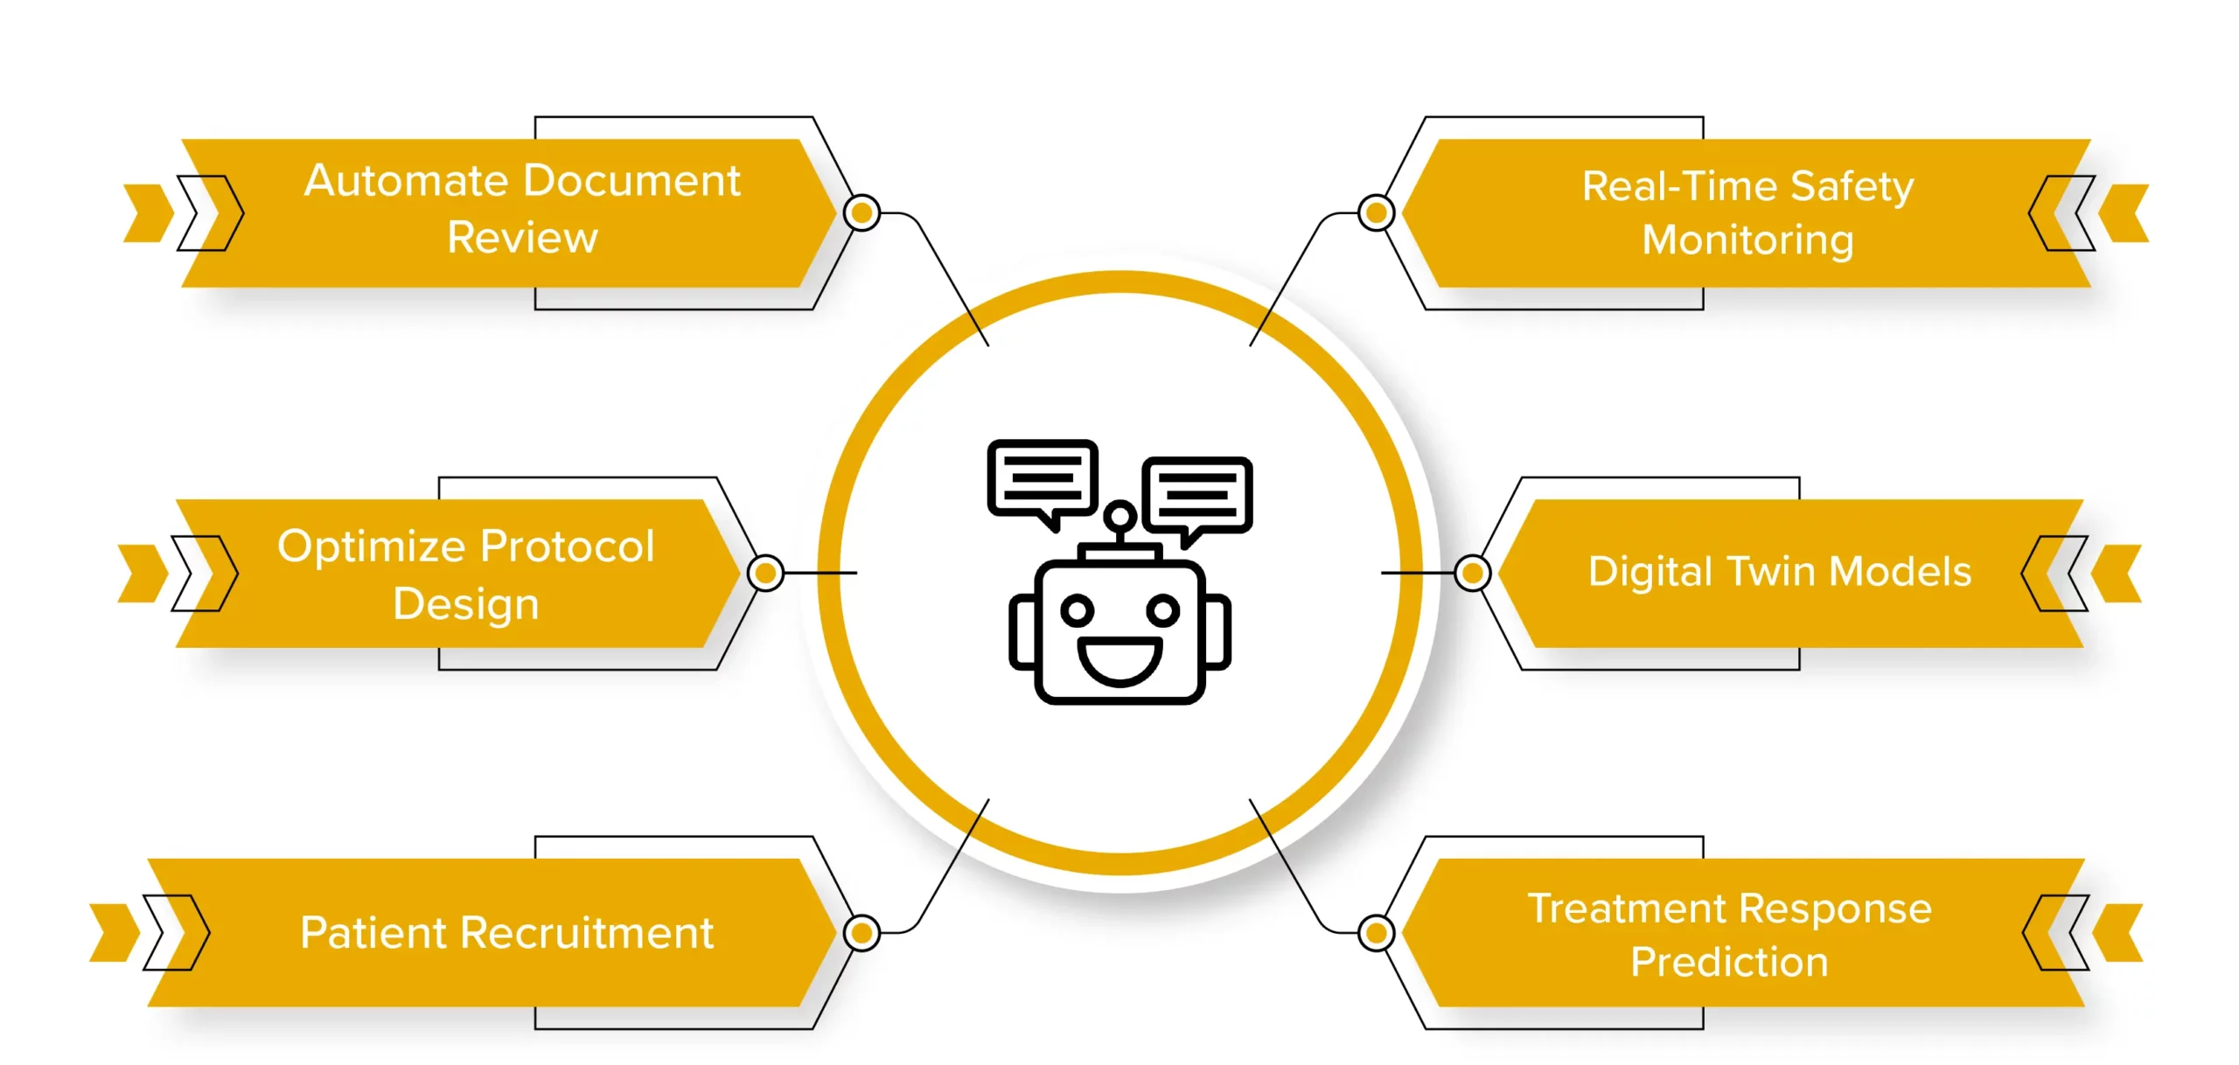
AI in Clinical Trials

Slide 48
Data Management and Analysis with AI
Handling Large Datasets: Efficient data processing and storage.
Retinal Imaging Analysis: Advanced image recognition and segmentation.
Genetic Data Integration: Combining genetic information with clinical data.
Improved Data Quality: Reducing errors and enhancing accuracy.

Slide 49
Monitoring and Outcome Assessment
Objective Evaluation: Reducing inter-observer variability.
Continuous Monitoring: Wearables and AI-powered apps for real-time tracking.
Predictive Analytics: Forecasting disease progression and complications.
Personalized Follow-Up Care: Tailored patient plans based on AI insights.

Slide 50
Challenges

Slide 51
Challenges
Diverse Data Collection: Strategies to gather inclusive datasets.
Enhancing Transparency: Developing explainable AI models.
Regulatory Compliance: Adhering to guidelines and standards.
Cost-Effective Solutions: Affordable AI implementations for smaller clinics.
Training and Education: Equipping healthcare providers with AI knowledge.

Slide 52
Ethical Considerations
Patient Privacy: Safeguarding sensitive data.
Bias and Fairness: Ensuring equitable AI outcomes.
Accountability: Defining responsibility in AI-driven decisions.
Informed Consent: Transparent communication with patients about AI use.

Slide 53


The Future of AI in Ophthalmology
AI-Driven Surgeries: AI enhances surgical precision, providing real-time feedback to improve outcomes and reduce errors.
Personalized Medicine: AI creates tailored treatment plans based on individual data, leading to more effective therapies for eye diseases.
Global Accessibility: AI tools extend high-quality eye care to underserved regions, improving diagnostics and treatment availability.

Slide 54

Foundational models and Federated learning
Federated Foundation Models: Privacy-Preserving and Collaborative Learning for Large Models. arXiv:2305.11414v3 [cs.LG] 19 Mar 2024. License: arXiv.org perpetual non-exclusive license
Notes:
Federated learning (often referred to as collaborative learning) is a decentralized approach to training machine learning models. It doesn't require an exchange of data from client devices to global servers. Instead, the raw data on edge devices is used to train the model locally, increasing data privacy. Foundation models use self-supervised learning to create labels from input data. This means no one has instructed or trained the model with labeled training data sets. driving advancements and propelling the development of privacy-preserving and scalable AI systems.

Slide 55
Conclusion
Rapid growth over the past decade
Prediction and generation tasks
Auto machine learning technologies will allow more researchers easier access to AI tools for research and analysis
Data sharing restrictions - federated learning
AI is still in its infancy with a promising future of providing clinically useful biomarkers and enabling personalized treatment

Slide 56





Acknowledgement
Kiran V
Josh Ong
Brian Rosario
Amrish Selvam
Md Abdul
Supriya Arora
Jose Alain Sahel
Grant Support
NIH CORE Grant P30 EY08098

Slide 57












Choroidal Analysis Research (CAR) Team
JAY CHHABLANI, MD
KIRAN KUMAR VUPPARABOINA, PHD
Sandeep Chandra, Bollepalli, PHD
JOSÉ-ALAIN SAHEL, MD
Image Processing and Artificial Intelligence Team
Clinical team
MOHAMMED NASAR IBRAHIM, PHD
ADARSH GADARI
Sharat Chandra
Elham SAdeghi
AMRISH SELVAM
ARMAN ZARNEGAR
Katherine Du
Stavan Shah
jay.chhablani@gmail.com

Slide 58

Get in touch
jay.chhablani@gmail.com
chhablanijk2@upmc.edu

Slide 59

UPMC Vision Institute, Pittsburgh
Thank you for your attention

